Slide 1
HTML
Hyper Text Markup Language

Slide 2
HTML Introduction
HTML is the standard markup language for creating Web pages.

Slide 3
What is HTML?
HTML stands for Hyper Text Markup Language
HTML is the standard markup language for creating Web pages
HTML describes the structure of a Web page
HTML consists of a series of elements
HTML elements tell the browser how to display the content
HTML elements label pieces of content such as "this is a heading", "this is a paragraph", "this is a link", etc.

Slide 4
A Simple HTML Document
<!DOCTYPE html>
<html>
<head>
<title>Page Title</title>
</head>
<body>
<h1>My First Heading</h1>
<p>My first paragraph.</p>
</body>
</html>

Slide 5
Example Explained
The <!DOCTYPE html> declaration defines that this document is an HTML5 document
The <html> element is the root element of an HTML page
The <head> element contains meta information about the HTML page
The <title> element specifies a title for the HTML page (which is shown in the browser's title bar or in the page's tab)
The <body> element defines the document's body, and is a container for all the visible contents, such as headings, paragraphs, images, hyperlinks, tables, lists, etc.
The <h1> element defines a large heading
The <p> element defines a paragraph

Slide 6
What is an HTML Element?
An HTML element is defined by a start tag, some content, and an end tag:
<tagname> Content goes here... </tagname>
The HTML element is everything from the start tag to the end tag:
<h1>My First Heading</h1>
<p>My first paragraph.</p>

Slide 7
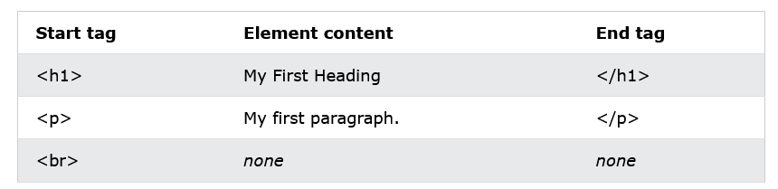

Slide 8
Note: Some HTML elements have no content (like the <br> element). These elements are called empty elements. Empty elements do not have an end tag!

Slide 9
Web Browsers
The purpose of a web browser (Chrome, Edge, Firefox, Safari) is to read HTML documents and display them correctly.
A browser does not display the HTML tags, but uses them to determine how to display the document:

Slide 10
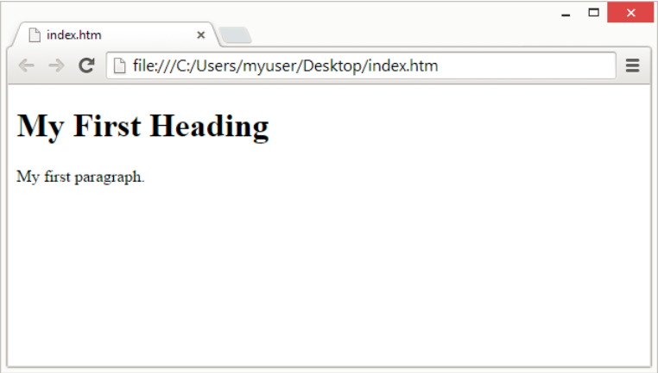

Slide 11
HTML Page Structure
Below is a visualization of an HTML page structure:

Slide 12
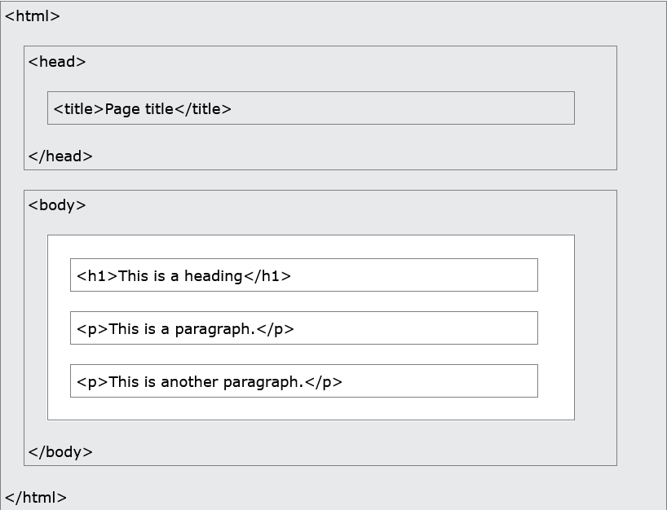

Slide 13
Note: The content inside the <body> section (the white area above) will be displayed in a browser. The content inside the <title> element will be shown in the browser's title bar or in the page's tab.

Slide 14
HTML History
Since the early days of the World Wide Web, there have been many versions of HTML

Slide 15
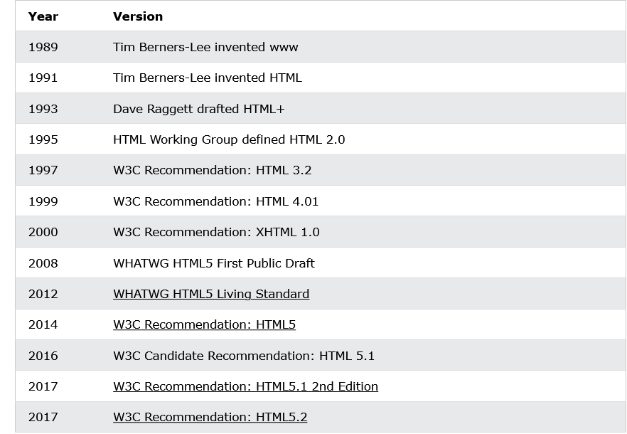

Slide 16
HTML Editors
A simple text editor is all you need to learn HTML.

Slide 17
Learn HTML Using Notepad or TextEdit
Web pages can be created and modified by using professional HTML editors.
However, for learning HTML we recommend a simple text editor like Notepad (PC) or TextEdit (Mac).
It is believed that using a simple text editor is a good way to learn HTML.
Follow the steps below to create your first web page with Notepad or TextEdit.

Slide 18
Step 1: Open Notepad (PC)
Windows 8 or later:
Open the Start Screen (the window symbol at the bottom left on your screen). Type Notepad.
Windows 7 or earlier:
Open Start > Programs > Accessories > Notepad

Slide 19
Step 1: Open TextEdit (Mac)
Open Finder > Applications > TextEdit
Also change some preferences to get the application to save files correctly. In Preferences > Format > choose "Plain Text"
Then under "Open and Save", check the box that says "Display HTML files as HTML code instead of formatted text".
Then open a new document to place the code.

Slide 20
Step 2: Write Some HTML
Write or copy the following HTML code into Notepad

Slide 21
<!DOCTYPE html> <html> <body> <h1>My First Heading</h1> <p>My first paragraph.</p> </body> </html>

Slide 22
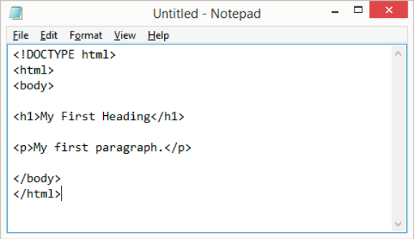

Slide 23
Step 3: Save the HTML Page
Save the file on your computer. Select File > Save as in the Notepad menu.
Name the file "index.htm" and set the encoding to UTF-8 (which is the preferred encoding for HTML files).

Slide 24
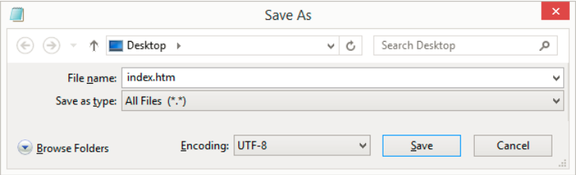

Slide 25
Tip: You can use either .htm or .html as file extension. There is no difference; it is up to you.

Slide 26
Step 4: View the HTML Page in Your Browser
Open the saved HTML file in your favorite browser (double click on the file, or right-click - and choose "Open with").
The result will look much like this

Slide 28
The <!DOCTYPE> Declaration
The <!DOCTYPE> declaration represents the document type, and helps browsers to display web pages correctly.
It must only appear once, at the top of the page (before any HTML tags).
The <!DOCTYPE> declaration is not case sensitive.
The <!DOCTYPE> declaration for HTML5 is:
<!DOCTYPE html>

Slide 29
HTML Headings
HTML headings are defined with the <h1> to <h6> tags.
<h1> defines the most important heading. <h6> defines the least important heading

Slide 30
<!DOCTYPE html>
<html>
<body>
<h1>This is heading 1</h1>
<h2>This is heading 2</h2>
<h3>This is heading 3</h3>
<h4>This is heading 4</h4>
<h5>This is heading 5</h5>
<h6>This is heading 6</h6>
</body>
</html>

Slide 31
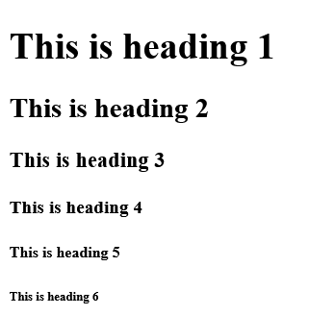

Slide 32
HTML Paragraphs
HTML paragraphs are defined with the <p> tag

Slide 33
<!DOCTYPE html>
<html>
<body>
<p>This is a paragraph.</p>
<p>This is another paragraph.</p>
</body>
</html>

Slide 34
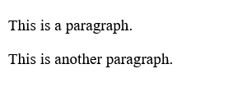

Slide 35
HTML Links
HTML links are defined with the <a> tag

Slide 36
<!DOCTYPE html>
<html>
<body>
<h2>HTML Links</h2>
<p>HTML links are defined with the a tag:</p>
<a href="https://www.w3schools.com">This is a link</a>
</body>
</html>

Slide 37
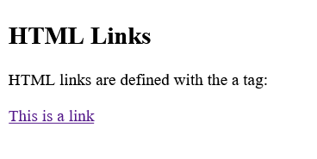

Slide 38
The link's destination is specified in the href attribute.
Attributes are used to provide additional information about HTML elements.

Slide 39
HTML Images
HTML images are defined with the <img> tag.
The source file (src), alternative text (alt), width, and height are provided as attributes

Slide 40
<!DOCTYPE html>
<html>
<body>
<h2>HTML Images</h2>
<p>HTML images are defined with the img tag:</p>
<img src="w3schools.jpg" alt="W3Schools.com" width="104" height="142">
</body>
</html>

Slide 41
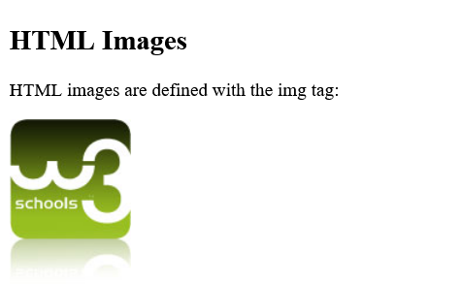

Slide 42
Nested HTML Elements
HTML elements can be nested (this means that elements can contain other elements).
All HTML documents consist of nested HTML elements.
The following example contains four HTML elements (<html>, <body>, <h1> and <p>)

Slide 43
<!DOCTYPE html>
<html>
<body>
<h1>My First Heading</h1>
<p>My first paragraph.</p>
</body>
</html>

Slide 44
Example Explained
The <html> element is the root element and it defines the whole HTML document.
It has a start tag <html> and an end tag </html>.
Then, inside the <html> element there is a <body> element:
<body> <h1>My First Heading</h1> <p>My first paragraph.</p> </body>

Slide 45
The <body> element defines the document's body.
It has a start tag <body> and an end tag </body>.
Then, inside the <body> element there are two other elements: <h1> and <p>:
<h1>My First Heading</h1> <p>My first paragraph.</p>

Slide 46
The <h1> element defines a heading.
It has a start tag <h1> and an end tag </h1>:
<h1>My First Heading</h1>
The <p> element defines a paragraph.
It has a start tag <p> and an end tag </p>:
<p>My first paragraph.</p>

Slide 47
Never Skip the End Tag
Some HTML elements will display correctly, even if you forget the end tag

Slide 48
<!DOCTYPE html>
<html>
<body>
<p>This is a paragraph.
<p>This is a paragraph.
</body>
</html>

Slide 49
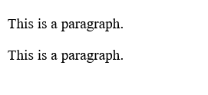

Slide 50
However, never rely on this! Unexpected results and errors may occur if you forget the end tag!

Slide 51
Empty HTML Elements
HTML elements with no content are called empty elements.
The <br> tag defines a line break, and is an empty element without a closing tag

Slide 52
<!DOCTYPE html>
<html>
<body>
<p>This is a <br> paragraph with a line break.</p>
</body>
</html>

Slide 53


Slide 54
HTML is Not Case Sensitive
HTML tags are not case sensitive: <P> means the same as <p>.
The HTML standard does not require lowercase tags, but W3C recommends lowercase in HTML, and demands lowercase for stricter document types like XHTML.

Slide 55
HTML Attributes
All HTML elements can have attributes
Attributes provide additional information about elements
Attributes are always specified in the start tag
Attributes usually come in name/value pairs like: name="value"

Slide 56
The href Attribute
The <a> tag defines a hyperlink. The href attribute specifies the URL of the page the link goes to:
Example
<a href="https://www.w3schools.com">Visit W3Schools</a>

Slide 57
The src Attribute
The <img> tag is used to embed an image in an HTML page. The src attribute specifies the path to the image to be displayed:
Example
<img src="img_girl.jpg">

Slide 58
There are two ways to specify the URL in the src attribute:
1. Absolute URL - Links to an external image that is hosted on another website. Example: src="https://www.w3schools.com/images/img_girl.jpg".
Notes: External images might be under copyright. If you do not get permission to use it, you may be in violation of copyright laws. In addition, you cannot control external images; it can suddenly be removed or changed.
2. Relative URL - Links to an image that is hosted within the website. Here, the URL does not include the domain name. If the URL begins without a slash, it will be relative to the current page. Example: src="img_girl.jpg". If the URL begins with a slash, it will be relative to the domain. Example: src="/images/img_girl.jpg".
Tip: It is almost always best to use relative URLs. They will not break if you change domain.

Slide 59
The width and height Attributes
The <img> tag should also contain the width and height attributes, which specify the width and height of the image (in pixels):
Example
<img src="img_girl.jpg" width="500" height="600">

Slide 60
The alt Attribute
The required alt attribute for the <img> tag specifies an alternate text for an image, if the image for some reason cannot be displayed. This can be due to a slow connection, or an error in the src attribute, or if the user uses a screen reader.
Example
<img src="img_girl.jpg" alt="Girl with a jacket">

Slide 61
The style Attribute
The style attribute is used to add styles to an element, such as color, font, size, and more.
Example
<p style="color:red;">This is a red paragraph.</p>

Slide 62
The lang Attribute
You should always include the lang attribute inside the <html> tag, to declare the language of the Web page. This is meant to assist search engines and browsers.
The following example specifies English as the language:
<!DOCTYPE html> <html lang="en"> <body> ... </body> </html>

Slide 63
Country codes can also be added to the language code in the lang attribute. So, the first two characters define the language of the HTML page, and the last two characters define the country.
The following example specifies English as the language and United States as the country:
<!DOCTYPE html> <html lang="en-US"> <body> ... </body> </html>

Slide 64
The title Attribute
The title attribute defines some extra information about an element.
The value of the title attribute will be displayed as a tooltip when you mouse over the element:
Example
<p title="I'm a tooltip">This is a paragraph.</p>

Slide 65
Always Use Lowercase Attributes
The HTML standard does not require lowercase attribute names.
The title attribute (and all other attributes) can be written with uppercase or lowercase like title or TITLE.
However, W3C recommends lowercase attributes in HTML, and demands lowercase attributes for stricter document types like XHTML.

Slide 66
Always Quote Attribute Values
The HTML standard does not require quotes around attribute values.
However, W3C recommends quotes in HTML, and demands quotes for stricter document types like XHTML.
Good:
<a href="https://www.w3schools.com/html/">Visit our HTML tutorial</a>
Bad:
<a href=https://www.w3schools.com/html/>Visit our HTML tutorial</a>

Slide 67
Single or Double Quotes?
Double quotes around attribute values are the most common in HTML, but single quotes can also be used.
In some situations, when the attribute value itself contains double quotes, it is necessary to use single quotes:
<p title='John "ShotGun" Nelson'>
Or vice versa:
<p title="John 'ShotGun' Nelson">

Slide 68
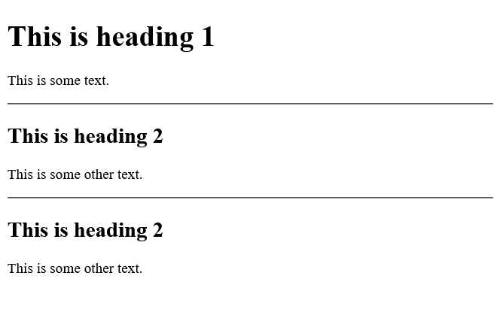
HTML Horizontal Rules
The <hr> tag defines a thematic break in an HTML page, and is most often displayed as a horizontal rule.
The <hr> element is used to separate content (or define a change) in an HTML page:
Example
<h1>This is heading 1</h1> <p>This is some text.</p> <hr> <h2>This is heading 2</h2> <p>This is some other text.</p> <hr>

Slide 69
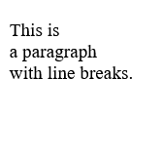
HTML Line Breaks
The HTML <br> element defines a line break.
Use <br> if you want a line break (a new line) without starting a new paragraph:
Example
<p>This is<br>a paragraph<br>with line breaks.</p>

Slide 70
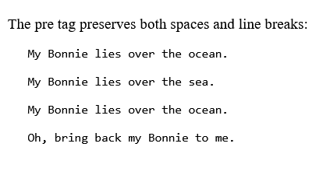
The HTML <pre> Element
The HTML <pre> element defines preformatted text.
The text inside a <pre> element is displayed in a fixed-width font (usually Courier), and it preserves both spaces and line breaks:
Example
<pre> My Bonnie lies over the ocean. My Bonnie lies over the sea. My Bonnie lies over the ocean. Oh, bring back my Bonnie to me. </pre>

Slide 71
HTML Text Formatting
HTML contains several elements for defining text with a special meaning.

Slide 72
HTML Formatting Elements
Formatting elements were designed to display special types of text:
<b> - Bold text
<strong> - Important text
<i> - Italic text
<em> - Emphasized text
<mark> - Marked text
<small> - Smaller text
<del> - Deleted text
<ins> - Inserted text
<sub> - Subscript text
<sup> - Superscript text

Slide 73

HTML <del> Element
The HTML <del> element defines text that has been deleted from a document. Browsers will usually strike a line through deleted text:
Example
<p>My favorite color is <del>blue</del> red.</p>

Slide 74

HTML <ins> Element
The HTML <ins> element defines a text that has been inserted into a document. Browsers will usually underline inserted text:
Example
<p>My favorite color is <del>blue</del> <ins>red</ins>.</p>

Slide 75
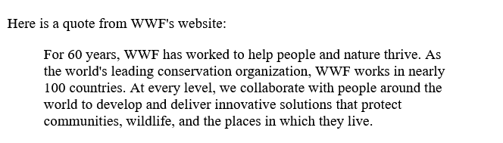
HTML <blockquote> for Quotations
The HTML <blockquote> element defines a section that is quoted from another source.
Browsers usually indent <blockquote> elements.
Example
<p>Here is a quote from WWF's website:</p> <blockquote cite="http://www.worldwildlife.org/who/index.html"> For 60 years, WWF has worked to help people and nature thrive. As the world's leading conservation organization, WWF works in nearly 100 countries. At every level, we collaborate with people around the world to develop and deliver innovative solutions that protect communities, wildlife, and the places in which they live. </blockquote>

Slide 76
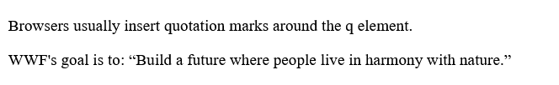
HTML <q> for Short Quotations
The HTML <q> tag defines a short quotation.
Browsers normally insert quotation marks around the quotation.
Example
<p>WWF's goal is to: <q>Build a future where people live in harmony with nature.</q></p>

Slide 77
HTML <abbr> for Abbreviations
The HTML <abbr> tag defines an abbreviation or an acronym, like "HTML", "CSS", "Mr.", "Dr.", "ASAP", "ATM".
Marking abbreviations can give useful information to browsers, translation systems and search-engines.
Tip: Use the global title attribute to show the description for the abbreviation/acronym when you mouse over the element.
Example
<p>The <abbr title="World Health Organization">WHO</abbr> was founded in 1948.</p>

Slide 78
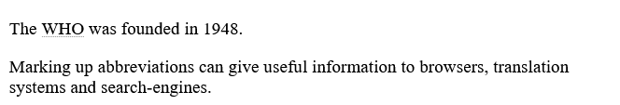

Slide 79
HTML <address> for Contact Information
The HTML <address> tag defines the contact information for the author/owner of a document or an article.
The contact information can be an email address, URL, physical address, phone number, social media handle, etc.
The text in the <address> element usually renders in italic, and browsers will always add a line break before and after the <address> element.

Slide 80
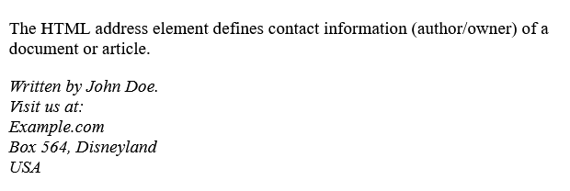
Example
<address> Written by John Doe.<br> Visit us at:<br> Example.com<br> Box 564, Disneyland<br> USA </address>

Slide 81
HTML <cite> for Work Title
The HTML <cite> tag defines the title of a creative work (e.g. a book, a poem, a song, a movie, a painting, a sculpture, etc.).
Note: A person's name is not the title of a work.
The text in the <cite> element usually renders in italic.
Example
<p><cite>The Scream</cite> by Edvard Munch. Painted in 1893.</p>

Slide 82
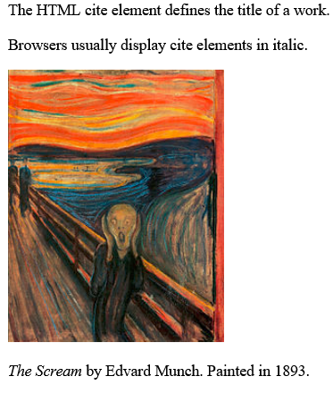

Slide 83
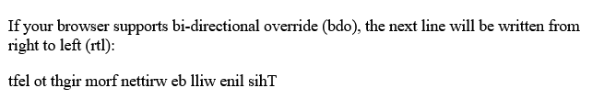
HTML <bdo> for Bi-Directional Override
BDO stands for Bi-Directional Override.
The HTML <bdo> tag is used to override the current text direction:
Example
<bdo dir="rtl">This text will be written from right to left</bdo>

Slide 84
HTML Comments
HTML comments are not displayed in the browser, but they can help document your HTML source code.
HTML Comment Tag
You can add comments to your HTML source by using the following syntax:
<!-- Write your comments here -->
Notice that there is an exclamation point (!) in the start tag, but not in the end tag.
Note: Comments are not displayed by the browser, but they can help document your HTML source code.

Slide 85
With comments you can place notifications and reminders in your HTML code:
Example
<!-- This is a comment --> <p>This is a paragraph.</p> <!-- Remember to add more information here -->

Slide 86
HTML Tables
HTML tables allow web developers to arrange data into rows and columns.
A table in HTML consists of table cells inside rows and columns.

Slide 87
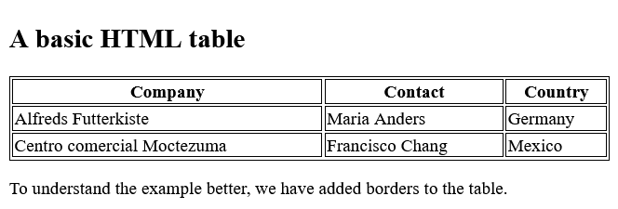
Example
<table> <tr> <th>Company</th> <th>Contact</th> <th>Country</th> </tr> <tr> <td>Alfreds Futterkiste</td> <td>Maria Anders</td> <td>Germany</td> </tr> <tr> <td>Centro comercial Moctezuma</td> <td>Francisco Chang</td> <td>Mexico</td> </tr> </table>

Slide 88
Table Cells
Each table cell is defined by a <td> and a </td> tag.
td stands for table data.
Everything between <td> and </td> are the content of the table cell.
Note: A table cell can contain all sorts of HTML elements: text, images, lists, links, other tables, etc.

Slide 89
Table Rows
Each table row starts with a <tr> and ends with a </tr> tag.
tr stands for table row.
You can have as many rows as you like in a table; just make sure that the number of cells are the same in each row.
Note: There are times when a row can have less or more cells than another.

Slide 90
Table Headers
Sometimes you want your cells to be table header cells. In those cases use the <th> tag instead of the <td> tag:
th stands for table header.
By default, the text in <th> elements are bold and centered, but you can change that with CSS.

Slide 91
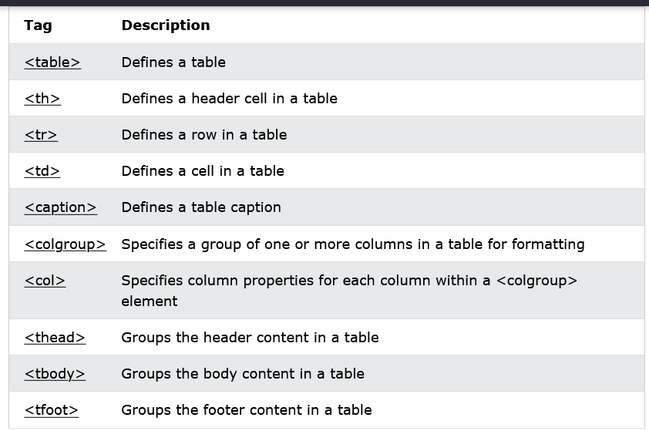

Slide 92
How To Add a Border
When you add a border to a table, you also add borders around each table cell

Slide 93
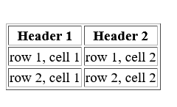
<table border="1"> <tr> <th>Header 1</th> <th>Header 2</th> </tr> <tr> <td>row 1, cell 1</td> <td>row 1, cell 2</td> </tr> <tr> <td>row 2, cell 1</td> <td>row 2, cell 2</td> </tr> </table>

Slide 94
HTML Table Sizes
Use the style attribute with the width or height properties to specify the size of a table, row or column.
To set the width of a table, add the style attribute to the <table> element

Slide 95
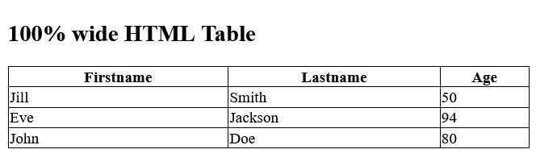
Set the width of the table to 100%:
<table style="width:100%"> <tr> <th>Firstname</th> <th>Lastname</th> <th>Age</th> </tr> <tr> <td>Jill</td> <td>Smith</td> <td>50</td> </tr> <tr> <td>Eve</td> <td>Jackson</td> <td>94</td> </tr> </table>

Slide 96
Note: Using a percentage as the size unit for a width means how wide will this element be compared to its parent element, which in this case is the <body> element.
To set the size of a specific column, add the style attribute on a <th> or <td> element

Slide 97
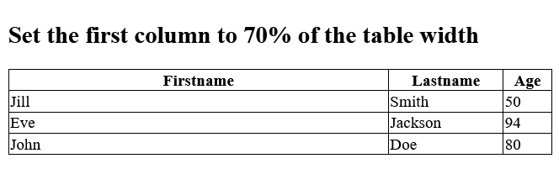
Set the width of the first column to 70%:
<table style="width:100%"> <tr> <th style="width:70%">Firstname</th> <th>Lastname</th> <th>Age</th> </tr> <tr> <td>Jill</td> <td>Smith</td> <td>50</td> </tr> <tr> <td>Eve</td> <td>Jackson</td> <td>94</td> </tr> </table>

Slide 98
To set the height of a specific row, add the style attribute on a table row element

Slide 99
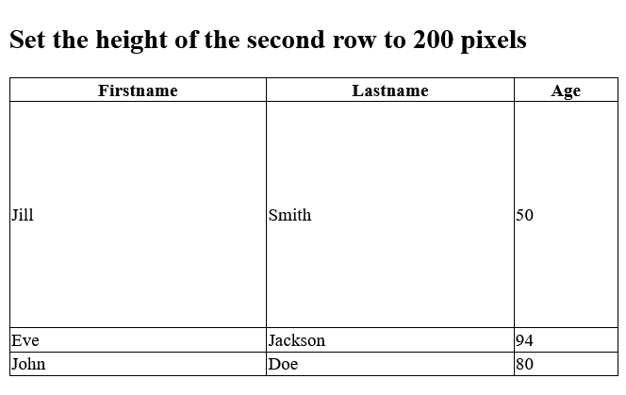
Set the height of the second row to 200 pixels:
<table style="width:100%"> <tr> <th>Firstname</th> <th>Lastname</th> <th>Age</th> </tr> <tr style="height:200px"> <td>Jill</td> <td>Smith</td> <td>50</td> </tr> <tr> <td>Eve</td> <td>Jackson</td> <td>94</td> </tr> </table>

Slide 100
HTML Table - Colspan
To make a cell span over multiple columns, use the colspan attribute
Note: The value of the colspan attribute represents the number of columns to span

Slide 101
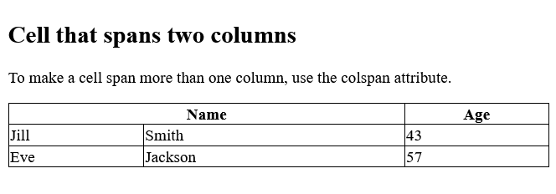
Example
<table> <tr> <th colspan="2">Name</th> <th>Age</th> </tr> <tr> <td>Jill</td> <td>Smith</td> <td>43</td> </tr> <tr> <td>Eve</td> <td>Jackson</td> <td>57</td> </tr> </table>

Slide 102
HTML Table - Rowspan
To make a cell span over multiple rows, use the rowspan attribute
Note: The value of the rowspan attribute represents the number of rows to span

Slide 103
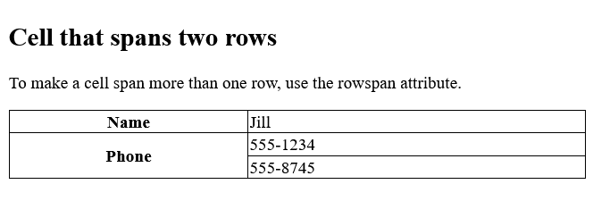
Example
<table> <tr> <th>Name</th> <td>Jill</td> </tr> <tr> <th rowspan="2">Phone</th> <td>555-1234</td> </tr> <tr> <td>555-8745</td> </tr> </table>

Slide 104
HTML Lists
HTML lists allow web developers to group a set of related items in lists

Slide 105
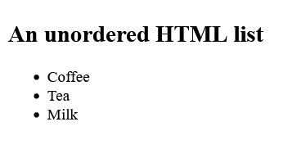
Unordered HTML List
An unordered list starts with the <ul> tag. Each list item starts with the <li> tag.
The list items will be marked with bullets (small black circles) by default
Example
<ul> <li>Coffee</li> <li>Tea</li> <li>Milk</li> </ul>

Slide 106
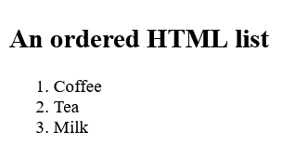
Ordered HTML List
An ordered list starts with the <ol> tag. Each list item starts with the <li> tag.
The list items will be marked with numbers by default
Example
<ol> <li>Coffee</li> <li>Tea</li> <li>Milk</li> </ol>

Slide 107
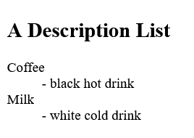
HTML Description Lists
HTML also supports description lists.
A description list is a list of terms, with a description of each term.
The <dl> tag defines the description list, the <dt> tag defines the term (name), and the <dd> tag describes each term
Example
<dl> <dt>Coffee</dt> <dd>- black hot drink</dd> <dt>Milk</dt> <dd>- white cold drink</dd> </dl>

Slide 108
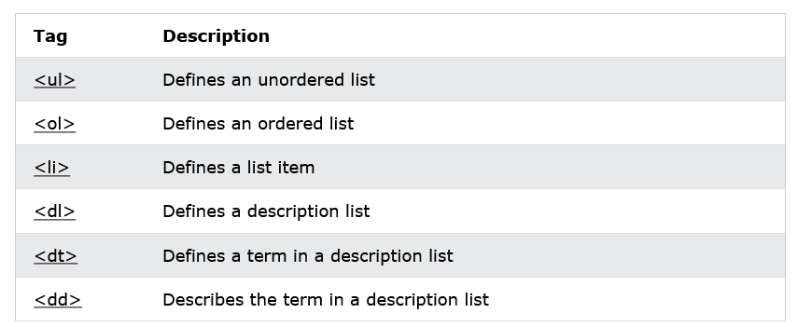
HTML List Tags

Slide 109
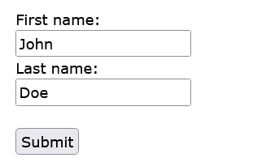
HTML Forms
An HTML form is used to collect user input. The user input is most often sent to a server for processing.

Slide 110
The <form> Element
The HTML <form> element is used to create an HTML form for user input:
<form> . form elements . </form>
The <form> element is a container for different types of input elements, such as: text fields, checkboxes, radio buttons, submit buttons, etc.

Slide 111
The <input> Element
The HTML <input> element is the most used form element.
An <input> element can be displayed in many ways, depending on the type attribute.
Here are some examples:

Slide 112
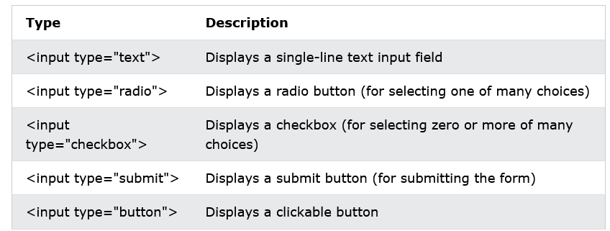

Slide 113
Text Fields
The <input type="text"> defines a single-line input field for text input.

Slide 114
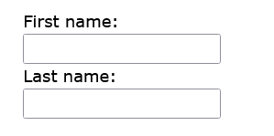
<form>
<label for="fname">First name:</label><br>
<input type="text" id="fname" name="fname"><br>
<label for="lname">Last name:</label><br>
<input type="text" id="lname" name="lname">
</form>

Slide 115
The <label> Element
The <label> tag defines a label for many form elements.
The <label> element is useful for screen-reader users, because the screen-reader will read out loud the label when the user focus on the input element.
The <label> element also help users who have difficulty clicking on very small regions (such as radio buttons or checkboxes) - because when the user clicks the text within the <label> element, it toggles the radio button/checkbox.
The for attribute of the <label> tag should be equal to the id attribute of the <input> element to bind them together.

Slide 116
Radio Buttons
The <input type="radio"> defines a radio button.
Radio buttons let a user select ONE of a limited number of choices.

Slide 117
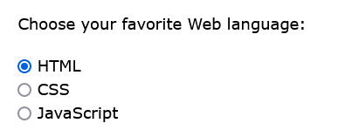
<p>Choose your favorite Web language:</p>
<form>
<input type="radio" id="html" name="fav_language" value="HTML">
<label for="html">HTML</label><br>
<input type="radio" id="css" name="fav_language" value="CSS">
<label for="css">CSS</label><br>
<input type="radio" id="javascript" name="fav_language" value="JavaScript">
<label for="javascript">JavaScript</label>
</form>

Slide 118
Checkboxes
The <input type="checkbox"> defines a checkbox.
Checkboxes let a user select ZERO or MORE options of a limited number of choices.

Slide 119
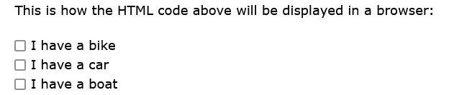
<form>
<input type="checkbox" id="vehicle1" name="vehicle1" value="Bike">
<label for="vehicle1"> I have a bike</label><br>
<input type="checkbox" id="vehicle2" name="vehicle2" value="Car">
<label for="vehicle2"> I have a car</label><br>
<input type="checkbox" id="vehicle3" name="vehicle3" value="Boat">
<label for="vehicle3"> I have a boat</label>
</form>

Slide 120
The Submit Button
The <input type="submit"> defines a button for submitting the form data to a form-handler.
The form-handler is typically a file on the server with a script for processing input data.
The form-handler is specified in the form's action attribute.

Slide 121
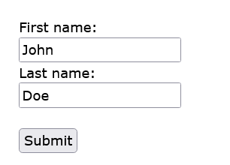
<form action="/action_page.php">
<label for="fname">First name:</label><br>
<input type="text" id="fname" name="fname" value="John"><br>
<label for="lname">Last name:</label><br>
<input type="text" id="lname" name="lname" value="Doe"><br><br>
<input type="submit" value="Submit">
</form>

Slide 122
The Name Attribute for <input>
Notice that each input field must have a name attribute to be submitted.
If the name attribute is omitted, the value of the input field will not be sent at all.

Slide 123
<form action="/action_page.php">
<label for="fname">First name:</label><br>
<input type="text" id="fname" value="John"><br><br>
<input type="submit" value="Submit">
</form>

Slide 124
The Action Attribute
The action attribute defines the action to be performed when the form is submitted.
Usually, the form data is sent to a file on the server when the user clicks on the submit button.
In the example below, the form data is sent to a file called "action_page.php". This file contains a server-side script that handles the form data

Slide 125
<form action="/action_page.php">
<label for="fname">First name:</label><br>
<input type="text" id="fname" name="fname" value="John"><br>
<label for="lname">Last name:</label><br>
<input type="text" id="lname" name="lname" value="Doe"><br><br>
<input type="submit" value="Submit">
</form>

Slide 126
The <textarea> Element
The <textarea> element defines a multi-line input field (a text area):
Example
<textarea name="message" rows="10" cols="30"> The cat was playing in the garden. </textarea>

Slide 127
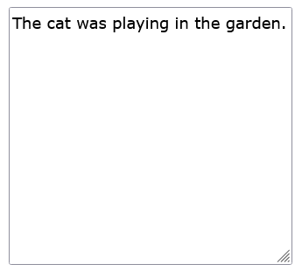
The rows attribute specifies the visible number of lines in a text area.
The cols attribute specifies the visible width of a text area.
This is how the HTML code above will be displayed in a browser

Slide 128

The <button> Element
The <button> element defines a clickable button:
Example
<button type="button" onclick="alert('Hello World!')">Click Me!</button>
Note: Always specify the type attribute for the button element. Different browsers may use different default types for the button element.

Slide 129
The <fieldset> and <legend> Elements
The <fieldset> element is used to group related data in a form.
The <legend> element defines a caption for the <fieldset> element.

Slide 130
<form action="/action_page.php"> <fieldset> <legend>Personalia:</legend> <label for="fname">First name:</label><br> <input type="text" id="fname" name="fname" value="John"><br> <label for="lname">Last name:</label><br> <input type="text" id="lname" name="lname" value="Doe"><br><br> <input type="submit" value="Submit"> </fieldset> </form>

Slide 131
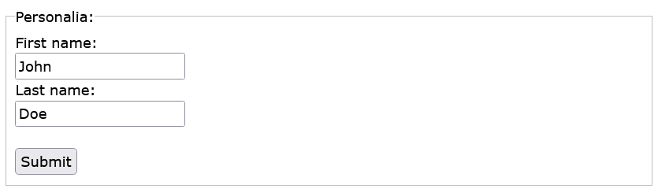

Slide 132
The <datalist> Element
The <datalist> element specifies a list of pre-defined options for an <input> element.
Users will see a drop-down list of the pre-defined options as they input data.
The list attribute of the <input> element, must refer to the id attribute of the <datalist> element.

Slide 133
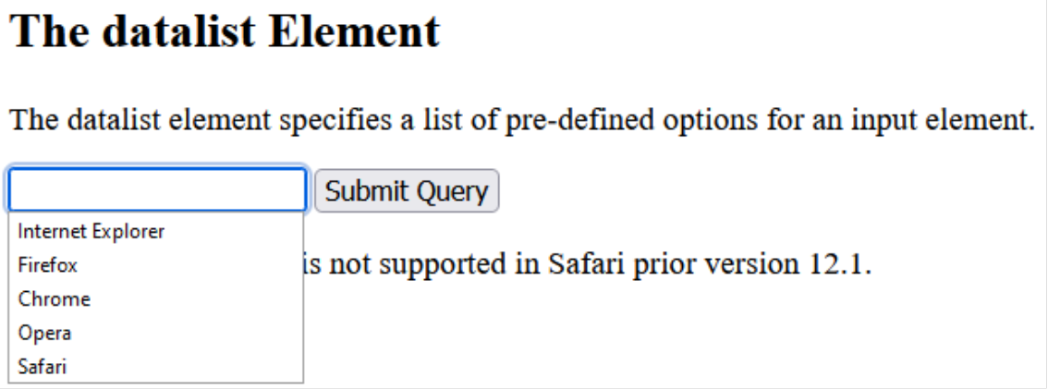
<form action="/action_page.php"> <input list="browsers"> <datalist id="browsers"> <option value="Internet Explorer"> <option value="Firefox"> <option value="Chrome"> <option value="Opera"> <option value="Safari"> </datalist> </form>

Slide 134
The <output> Element
The <output> element represents the result of a calculation (like one performed by a script).

Slide 135
<form action="/action_page.php" oninput="x.value=parseInt(a.value)+parseInt(b.value)"> 0 <input type="range" id="a" name="a" value="50"> 100 + <input type="number" id="b" name="b" value="50"> = <output name="x" for="a b"></output> <br><br> <input type="submit"> </form>

Slide 136
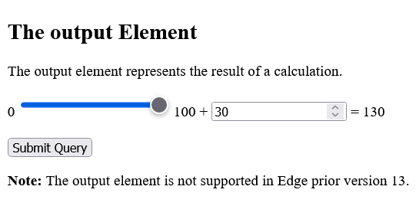

Slide 137
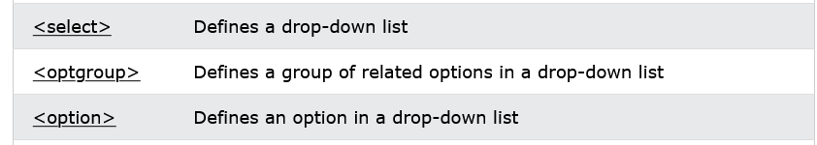
Other Elements

Slide 138
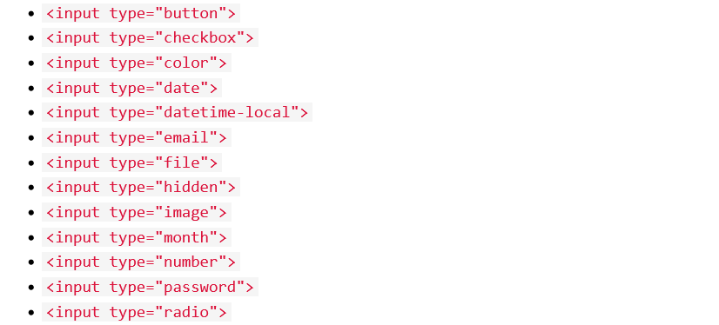
HTML Input Types

Slide 139
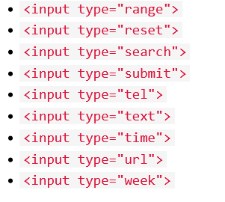

Slide 140
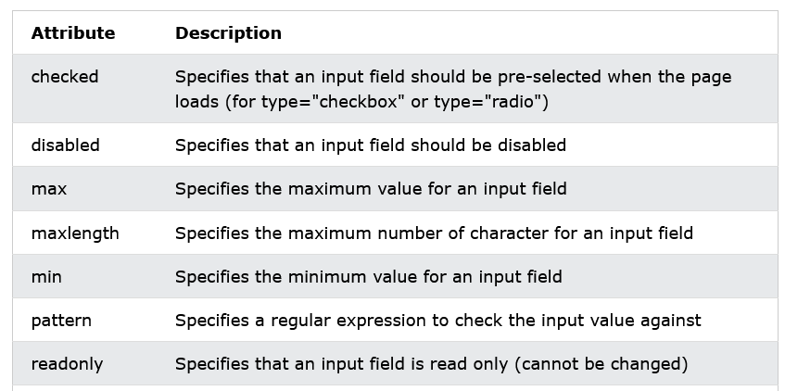
Input Restrictions

Slide 141
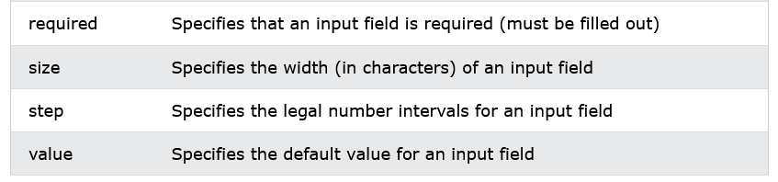

Slide 142
HTML Form Attributes

Slide 143
The formenctype Attribute
The input formenctype attribute specifies how the form-data should be encoded when submitted (only for forms with method="post").
Note: This attribute overrides the enctype attribute of the <form> element.
The formenctype attribute works with the following input types: submit and image.
A form with two submit buttons. The first sends the form-data with default encoding, the second sends the form-data encoded as "multipart/form-data"

Slide 144
<form action="/action_page_binary.asp" method="post"> <label for="fname">First name:</label> <input type="text" id="fname" name="fname"><br><br> <input type="submit" value="Submit"> <input type="submit" formenctype="multipart/form-data" value="Submit as Multipart/form-data"> </form>

Slide 145
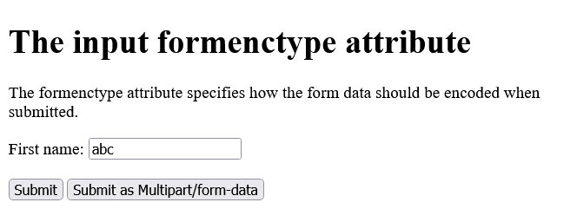
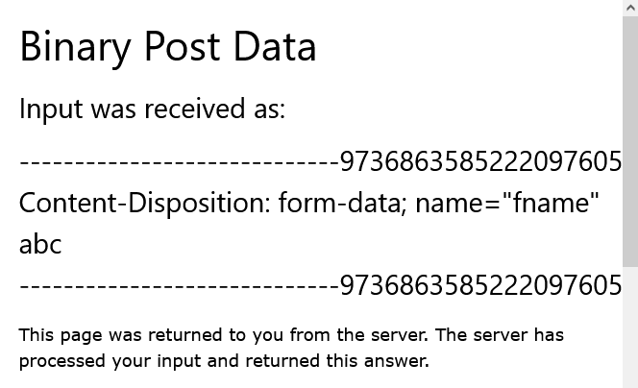
Submitted as Multipart/form-data

Slide 146
The Method Attribute
The input formmethod attribute defines the HTTP method for sending form-data to the action URL.
Note: This attribute overrides the method attribute of the <form> element.
The formmethod attribute works with the following input types: submit and image.
The form-data can be sent as URL variables (method="get") or as an HTTP post transaction (method="post").

Slide 147
Notes on the "get" method:
This method appends the form-data to the URL in name/value pairs
This method is useful for form submissions where a user want to bookmark the result
There is a limit to how much data you can place in a URL (varies between browsers), therefore, you cannot be sure that all of the form-data will be correctly transferred
Never use the "get" method to pass sensitive information! (password or other sensitive information will be visible in the browser's address bar)

Slide 148
Notes on the "post" method:
This method sends the form-data as an HTTP post transaction
Form submissions with the "post" method cannot be bookmarked
The "post" method is more robust and secure than "get", and "post" does not have size limitations
Tip: Always use POST if the form data contains sensitive or personal information!

Slide 149
A form with two submit buttons. The first sends the form-data with method="get". The second sends the form-data with method="post":
<form action="/action_page.php" method="get"> <label for="fname">First name:</label> <input type="text" id="fname" name="fname"><br><br> <label for="lname">Last name:</label> <input type="text" id="lname" name="lname"><br><br> <input type="submit" value="Submit using GET"> <input type="submit" formmethod="post" value="Submit using POST"> </form>

Slide 150
The Action Attribute
The action attribute defines the action to be performed when the form is submitted.
Usually, the form data is sent to a file on the server when the user clicks on the submit button.
In the example below, the form data is sent to a file called "action_page.php". This file contains a server-side script that handles the form data

Slide 151
On submit, send form data to "action_page.php":
<form action="/action_page.php"> <label for="fname">First name:</label><br> <input type="text" id="fname" name="fname" value="John"><br> <label for="lname">Last name:</label><br> <input type="text" id="lname" name="lname" value="Doe"><br><br> <input type="submit" value="Submit"> </form>

Slide 152
The Target Attribute
The target attribute specifies where to display the response that is received after submitting the form.
The default value is _self which means that the response will open in the current window.
<form action="/action_page.php" target="_blank">
The target attribute can have one of the following values

Slide 153
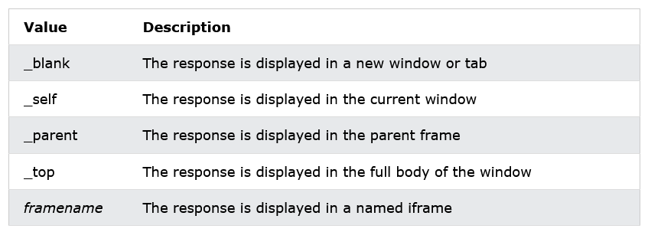

Slide 154
The Autocomplete Attribute
The autocomplete attribute specifies whether a form should have autocomplete on or off.
When autocomplete is on, the browser automatically complete values based on values that the user has entered before.
Example
A form with autocomplete on:
<form action="/action_page.php" autocomplete="on">

Slide 155
The Novalidate Attribute
The novalidate attribute is a boolean attribute.
When present, it specifies that the form-data (input) should not be validated when submitted.
Example
A form with a novalidate attribute:
<form action="/action_page.php" novalidate>

